Slide 1
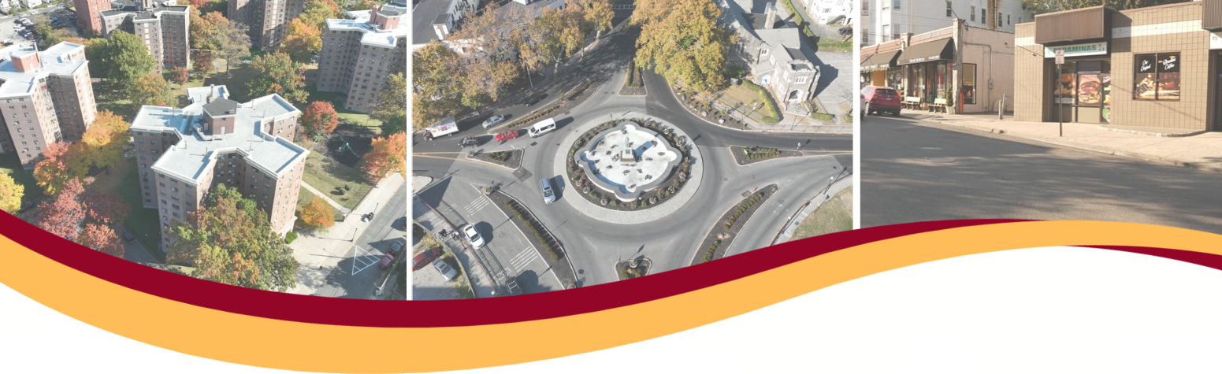
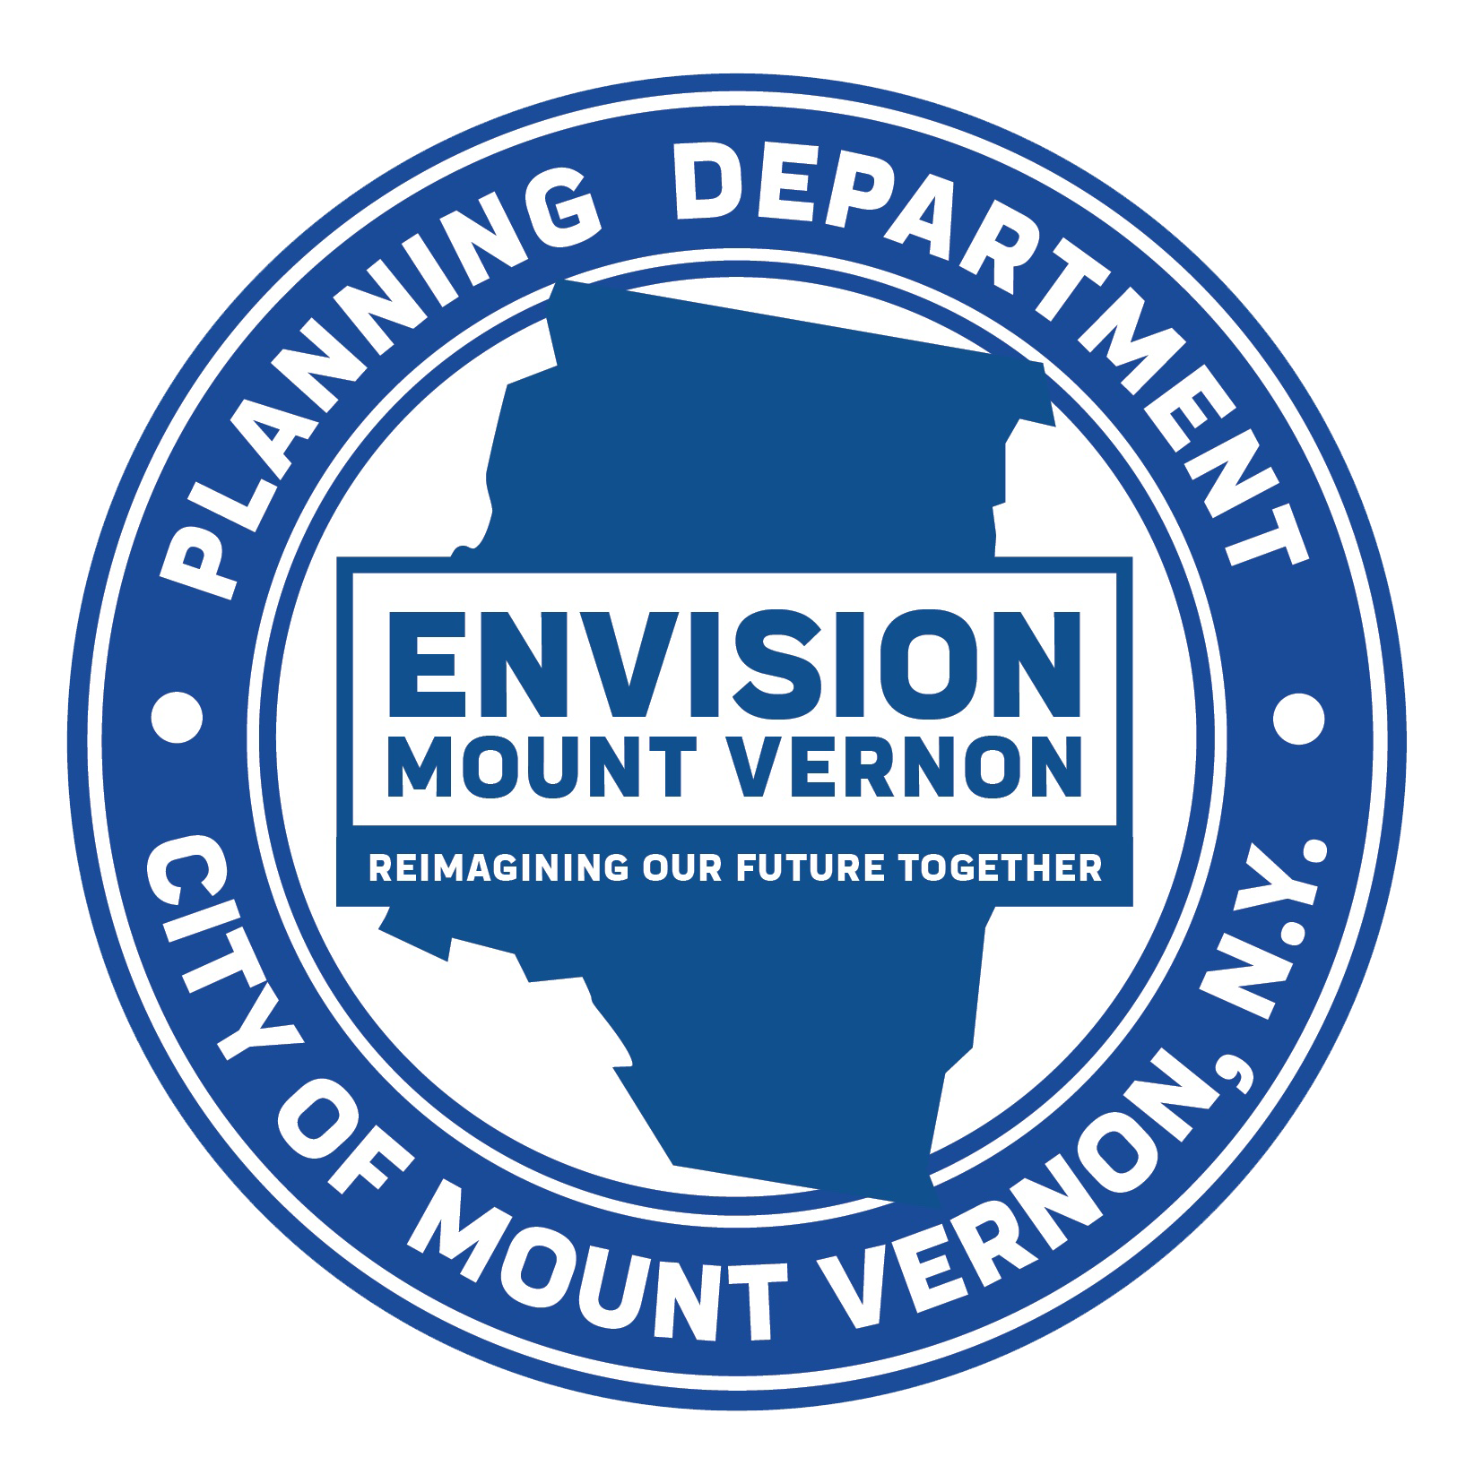
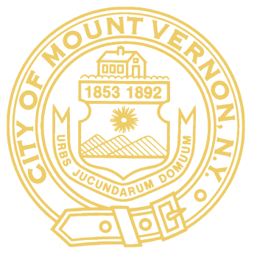
Mount Vernon Comprehensive Plan- Phase II
Industrial Businesses
Community Conversation
January 29, 2025

Slide 2

Welcome and Introductions
City of Mt. Vernon
Department of Planning & Community Development
Industrial Development Agency
Hosts
Business Council of Westchester
Mt. Vernon Chamber of Commerce
The Guidance Center of Westchester
Consultant Team
Cleary Consulting
AKRF
Pattern for Progress
BRS
Creative Urban Alchemy

Slide 3
Why Are We Here?
The goals of this community outreach process are as follows:
  Build trust, support, and open dialogue between community members, the city, and the consulting team.
  Identify and understand the community’s concerns and unique needs and preferences.
  Promote community participation throughout the comprehensive planning process.
  Obtain community support for land use decisions.
  Engage new resources and allies.
  Address overall community land use concerns and improve outcomes.

Slide 4
Meeting Rules
✔ Be respectful to others.
✔ Only one person will speak at a time.
✔ Keep an open mind.
✔ Please leave opportunities for others to speak.

Slide 5
Icebreaker
How many of you live in Mount Vernon?
How many of you work in Mount Vernon?
How many of you own a business in Mount Vernon?
How many of you work in an industrial business in Mount Vernon?
If you work in an industry, do you work in:
  Extraction (e.g. mining, quarries)
  Genetic (e.g. plant nurseries, animal kennels)
  Manufacturing
  Construction
  Transportation
  Warehousing

Slide 6
Industrial Heritage
Question 1
The City of Mount Vernon has an industrial legacy that is part of the identity of the city. What industries do you historically associate with Mount Vernon? What industries that survive today are tied to the history of the city?

Slide 7
Industrial Heritage
Question 2
What are the biggest attractions for businesses in Mount Vernon? What are the biggest reasons for a new business to choose Mt. Vernon over neighboring municipalities?

Slide 8
Mapping Exercise
We would like to do a mapping exercise with you to understand your thoughts about the borders between neighborhoods. What are the borders of Mt. Vernon’s industrial districts? Where does industry blend in with other uses?
  In blue, place a dot on the location of your place of work in Mt. Vernon
  In red, please draw in districts that you believe are predominantly industrial in character
  In purple, please draw in places where there are industrial uses that exist mixed-in with other commercial uses, or even residential uses

Slide 9
Land Use
Is your business in an industrial-only district, or is it mixed in with other types of uses such as commercial or residential? What are the advantages and disadvantages of each?

Slide 10
Infrastructure
Are there infrastructure challenges such as transportation, sewer, or waste disposal that have an impact on your business? What improvements would have a significant impact on Mt. Vernon businesses?

Slide 11
Workforce
Question 1
In your businesses, what percentage of the workforce lives in Mt. Vernon?
  Most or all
  Around half
  A few
  None

Slide 12
Workforce
Question 2
Do you have challenges in hiring the staffing you need in Mount Vernon? What skill sets are the most difficult to find?

Slide 13
Environment
What are the environmental challenges that currently exist in Mt. Vernon’s industrial neighborhoods that are the highest priority to address? Examples of this can include:
  Air pollution
  Ground contamination
  Runoff into water
  Dumping of waste
What steps would you like to see the city take to address these challenges?

Slide 14
Government Support
What programs from the City of Mount Vernon do you currently utilize to support your businesses? Are there other things that the city should be doing to either retain existing industries or attract new ones?

Slide 15
Vision
Question
What would you like Mt. Vernon to be known for?

Slide 16
Closing Remarks
  Upcoming Events
Save the Date
Spring 2025 – 2 Comp Plan Public Workshops

